Slide 1

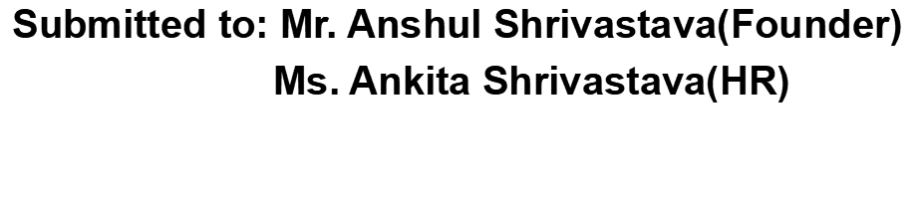

Dialogflow ChatBot
Building Conversational chatbot for weather condtion using Google Dialogflow Platform
By: Animesh Pandey

Slide 2
Contents
Introduction
Development Tools
System Requirements
Features
Snapshots
Source Code Link
learning from project
Future Scope
References

Slide 3
Introduction
The main objective of this project is to develop a dynamic, responsive chatbot using a natural language processing platform (Dialogflow), which will take input from user (in the chatroom) as the city name and reply with the weather condition of that particular city.

Slide 4
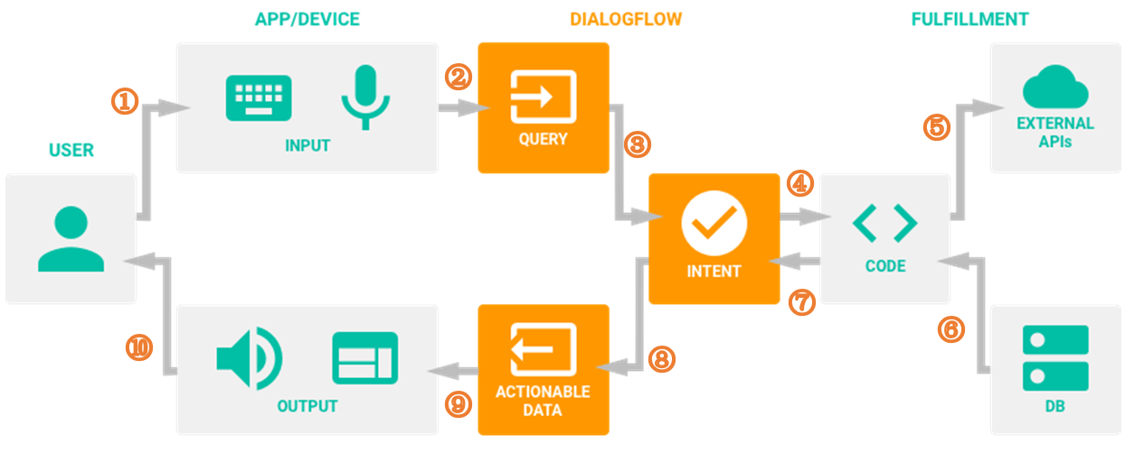
Working of Dialogflow

Slide 5
Development Tools
Dialogflow: It is a Google backed platform (so it uses Google's infrastructure, which means it can be scaled to million users). It uses natural language processing backed by Machine Learning.
Node.js: Under fullfillment section of an agent to create funtion for intended output for the user query.
Axios -npm js library is used to GET response from API.
Facebook: Dialogflow integration is done with facebook messenger to use facebook messenger app for e user to interact with chatbot.
openweathermap.org to access weather information.

Slide 6
System Requirements
Any Operating System
Internet Required
Web Browser
System Specs.
Ram 8GB
Processor Intel i5 8th gen.
64-bit OS, Windows 10 Pro

Slide 7
Features
Resposes to the user input “Hi” (greeting), using default Welcome Intent.
Can take user input as city name and reply with weather condition of the particular city along with temperature, using WeatherTest Intent.
Since Chatbot is integrated to Facebook messenger so it basically works on chat which makes it super user friendly.

Slide 8
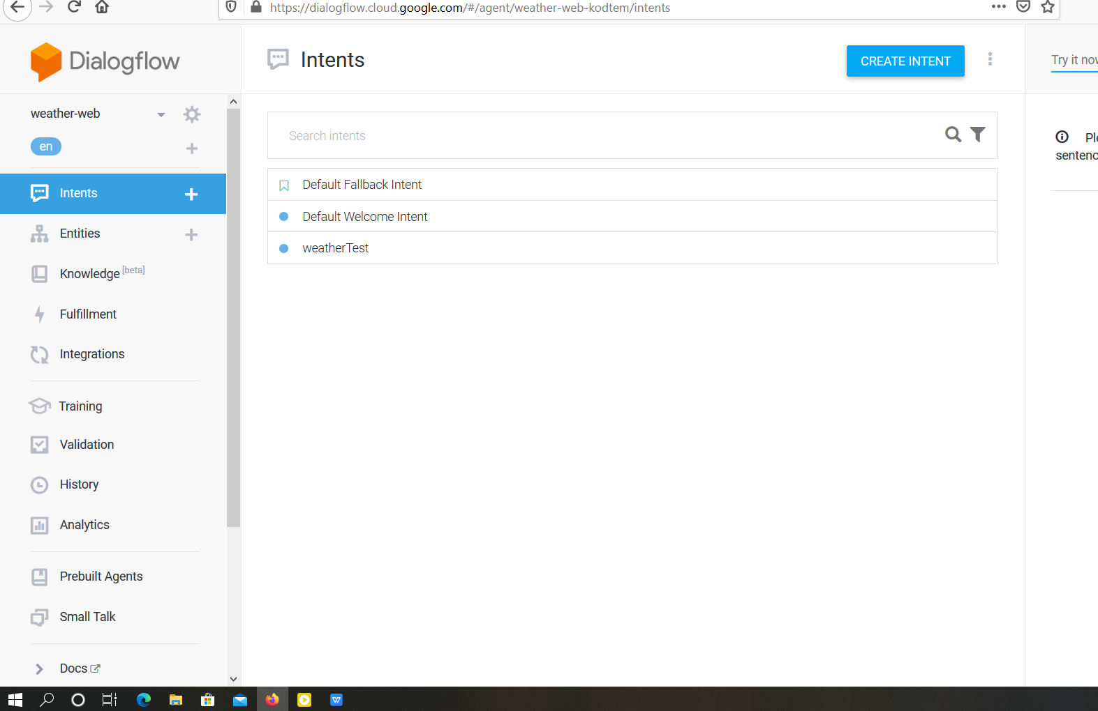
Snapshots
Agent: weather-bot,
Intents:

Slide 9
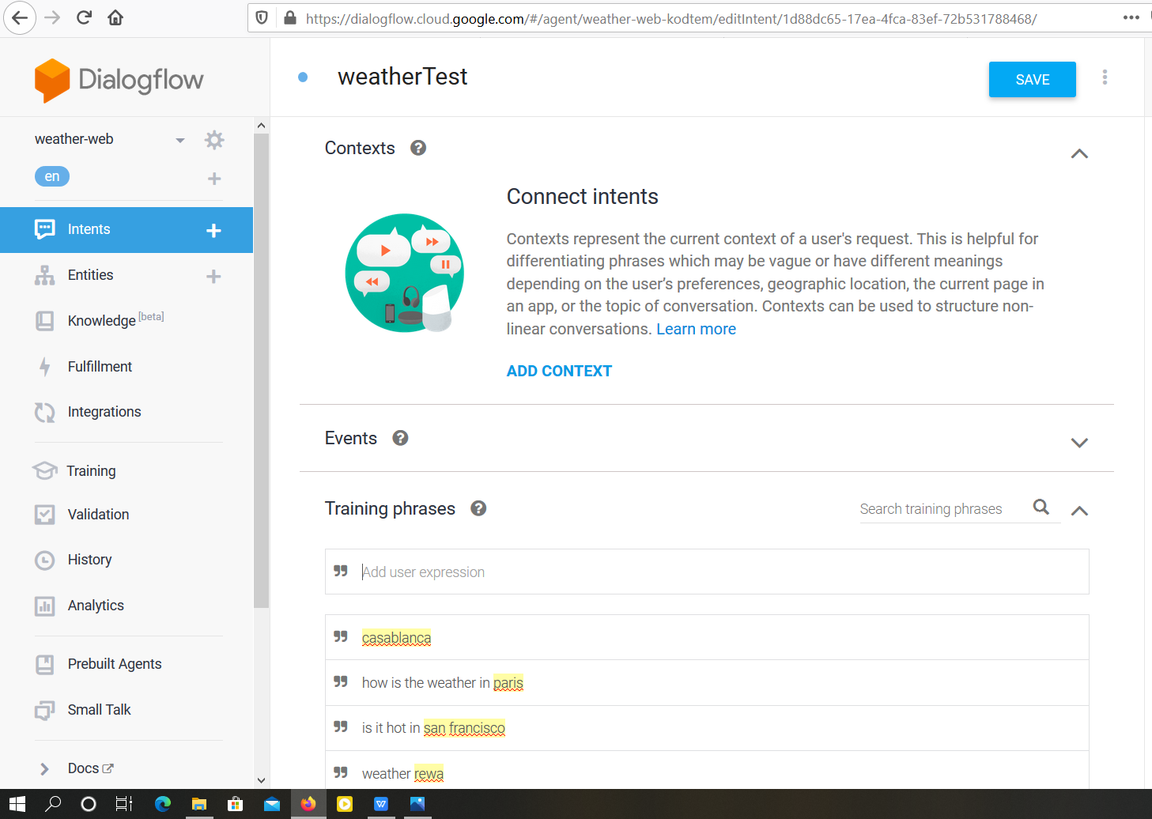
WeatherTest intent:

Slide 10
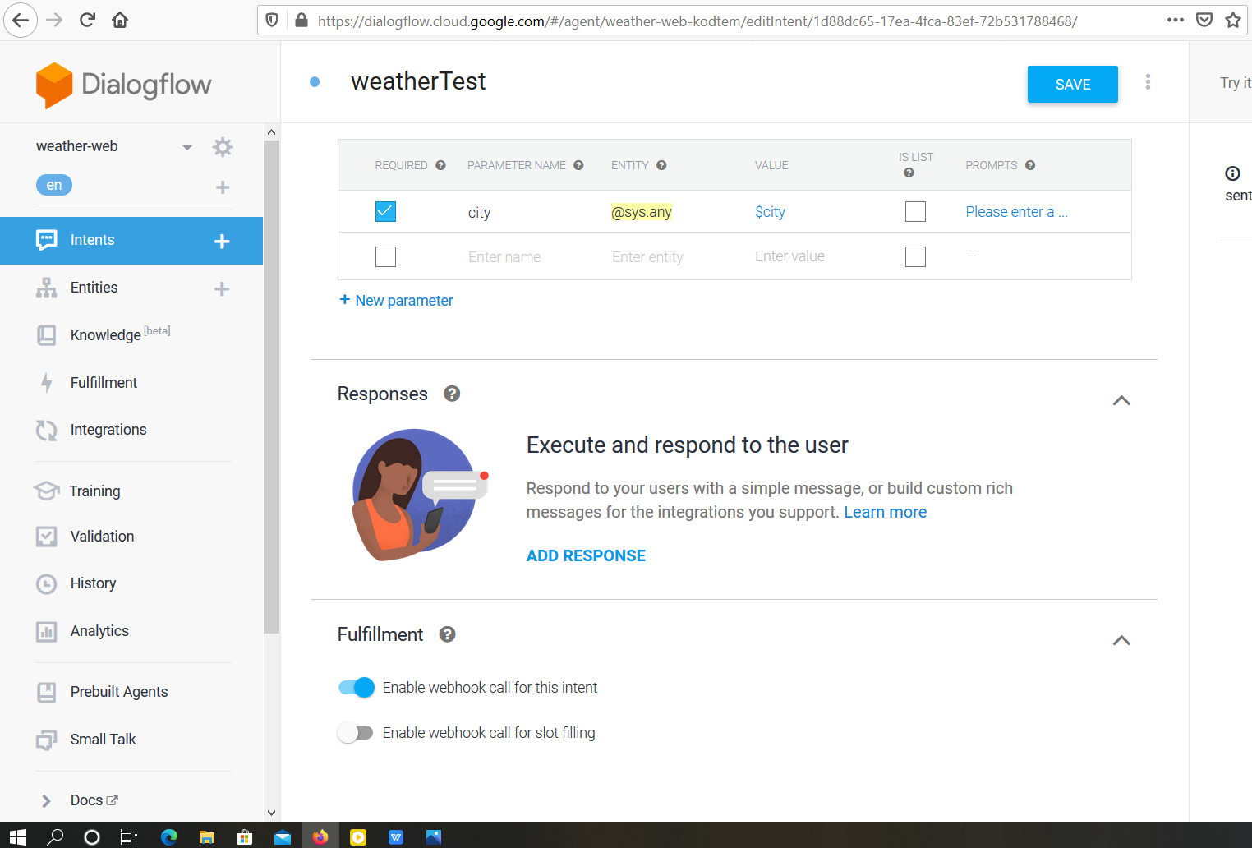
Fullfillment Enabled:

Slide 11
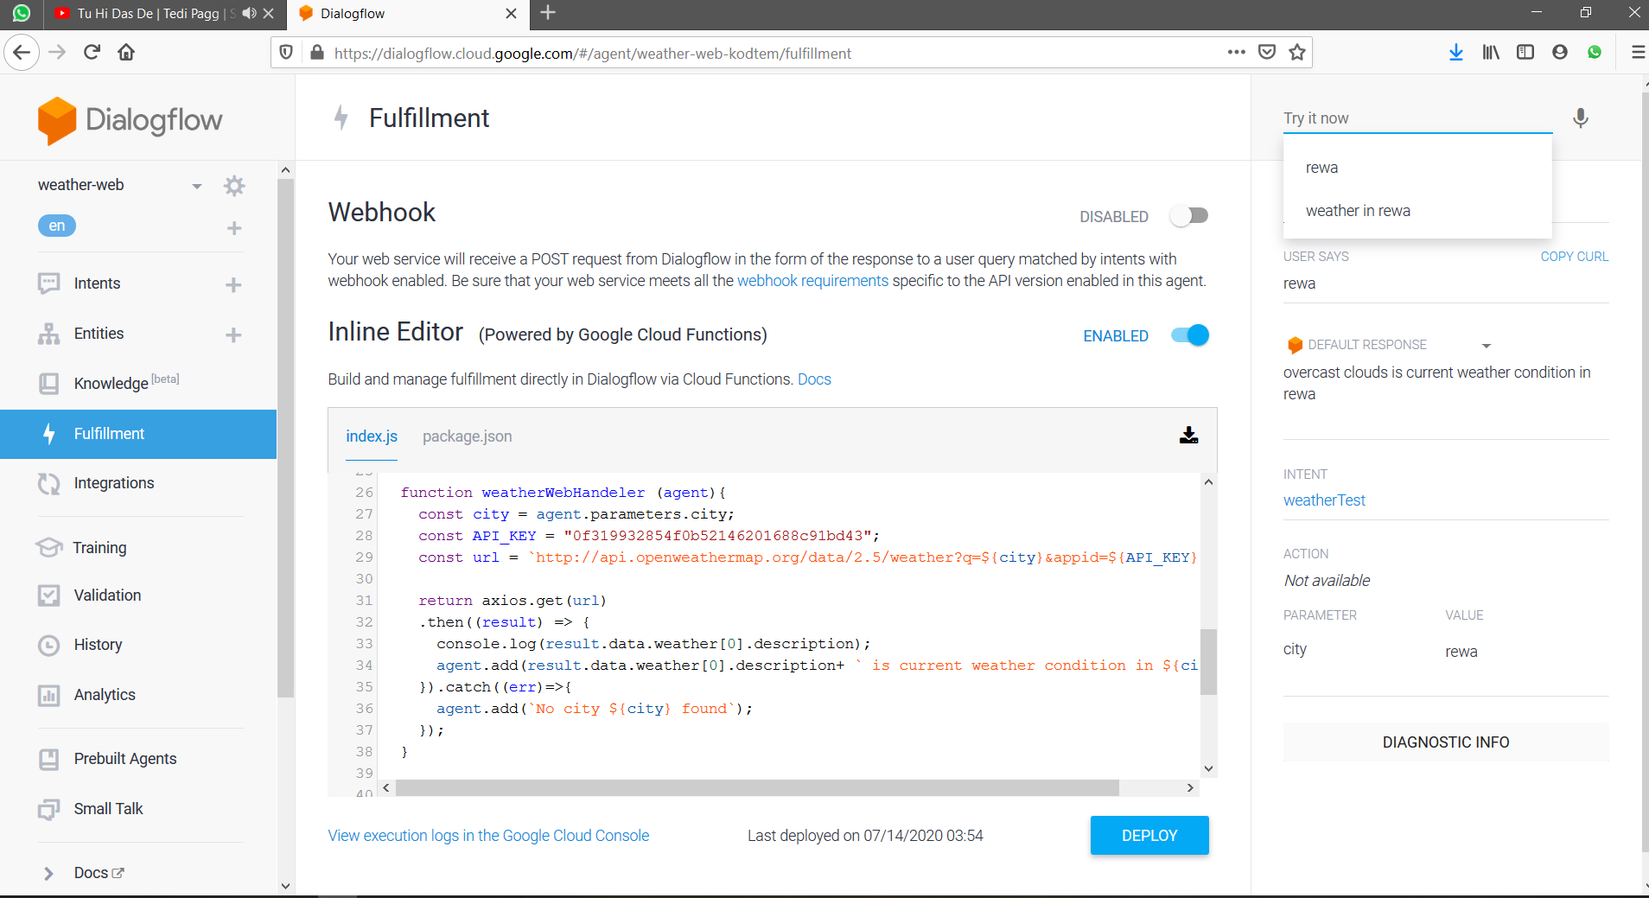
Inline Editor:

Slide 12
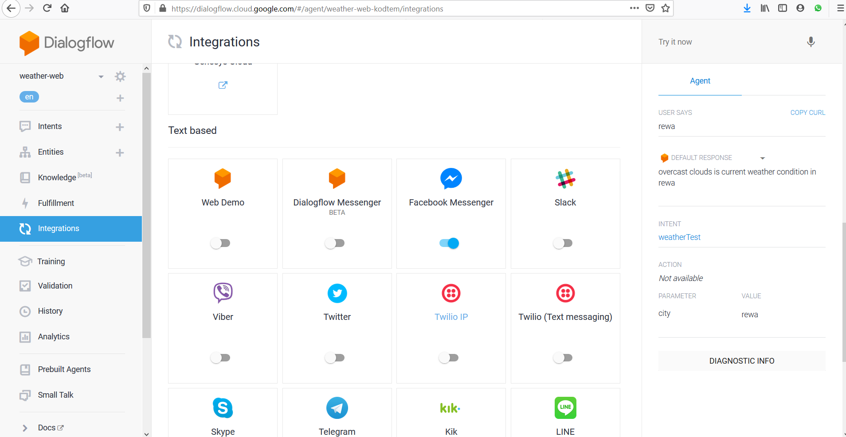
Integrations:

Slide 13


Source Code & Weather API link
https://github.com/devanimesh1/Weather-Chat-bot
http://api.openweathermap.org/data/2.5/weather?q=rewa&appid=0f319932854f0b52146201688c91bd43

Slide 14

Learning from this project
Working of Dialogflow
Using API in the inbuit Inline editor based on node.js to get output from desired website.
Used Google cloud console for execution log.
Created Billing account for the project.
Axios -npm (node package manager) promise based HTTP client fro t browser node.js.
Node.js library which deals with GET request.

Slide 15
Using external api's.
Working of Github repository.
Using Git bash to launch repo to github using git commands.
Basic working of Heroku server to launch an app there (**didn't implement that to this project).
Used Heroku CLI
Tried to create external webhook using node.js in Visual Studio then creating repo in git hub which was then to be deployed using heroku server and then in dialogflow under webhook fullfillment.

Slide 16
Furture Scope
Adding Rich text
Adding Links fo the elaborated description of weather.
Implementing this chatbot to a website.
It is pedicted that 88% of all customers service interactions will be powered by chatbots within 2 years.
By 2022 cost saving provided by chatbots will be over $ 8 Billion annually.

Slide 17

References
https://www.youtube.com/channel/UC6jTqfqZVWytUoKJplFrp9w
Other Youtube channels
https://www.github.com/ Some Github repositories
https://www.google.com/

Slide 18
Thankyou...

